Slide 1
Ütopia A technical solution to unifying the Boston Taxi experience
Team 4: Patrick Foley, Jerome Jayapal, Nathan McDonald, Michael Patterson
ISMT S-599 Capstone Seminar in Enterprise Systems, Summer 2015
Harvard Extension School
Instructor: Zoya Kinstler
Teaching Assistant: Takayuki Iida

Slide 2




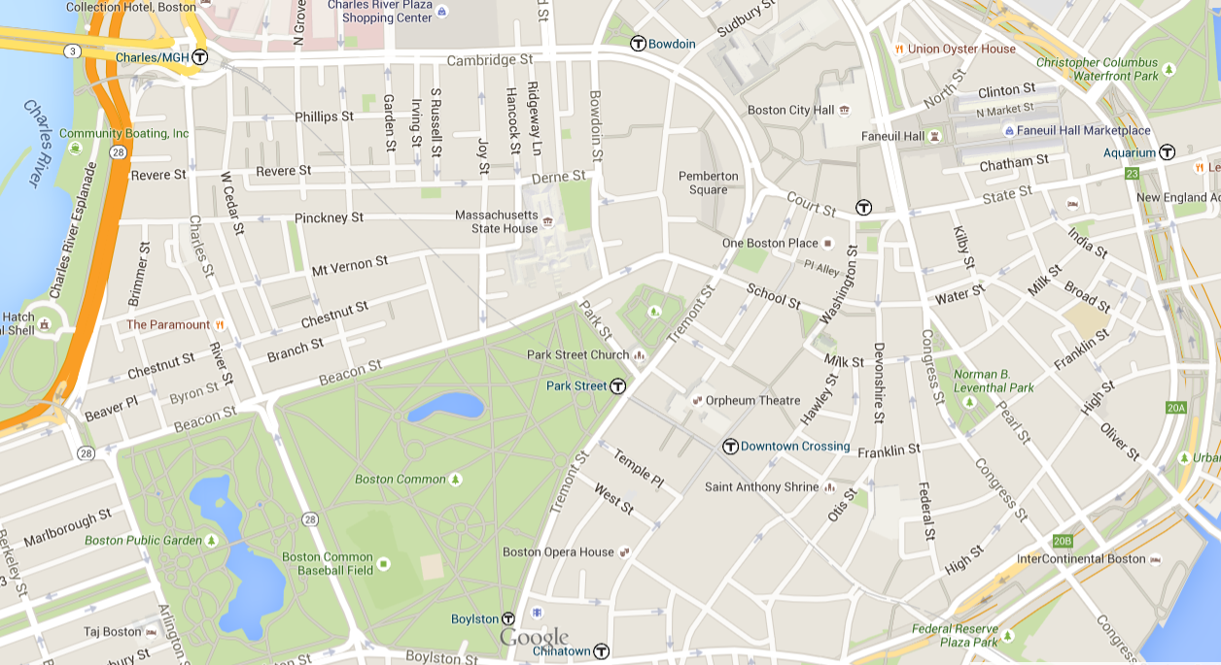




The Problem
The Solution
https://www.google.com/maps/place/Boston,+MA/
https://bostoncab.us/
http://boston-cab.com/

Slide 3
Business Case
The Ütopia Enterprise solution has the following objectives:
Increase taxi ridership by streamlining the entire hailing process
Decrease the average response time for Taxi pickups requested from a mobile app
Increase incentives for medallion owners to deliver high customer service via a feedback system
Reduce the number of Taxi cabs sitting idle
In short – to make is possible for taxis in Boston to compete with TNC’s like Uber and Lyft.

Slide 4
Why?
Innovation!!! The way our world functions
Health of Boston depends on reliable transportation (WINTER OF 2015!!!!!)
Conventions, tourism, events all count on a viable transportation infrastructure (2024 Olympic bid etc.)
Obligation (2004, hotel excise tax, rental car surcharge and ……..)

Slide 5
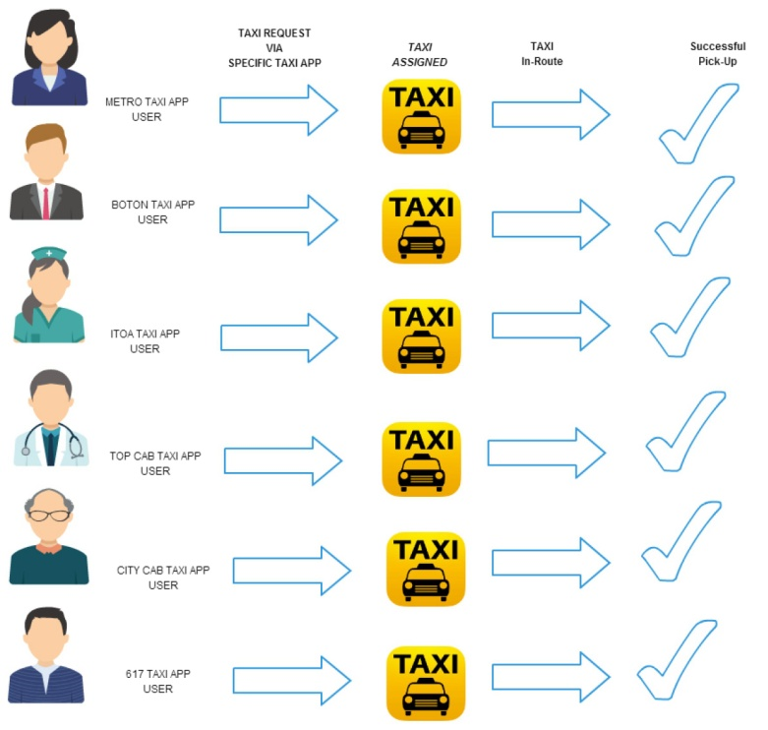
As-Is

Slide 6
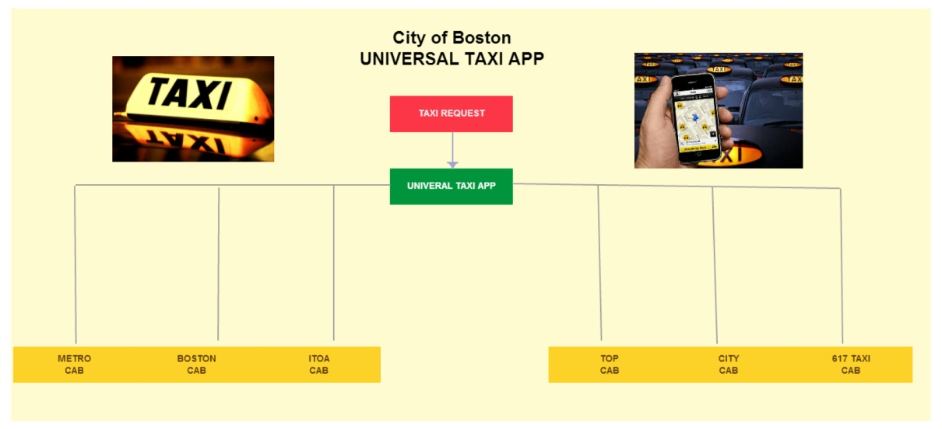
To Be

Slide 7
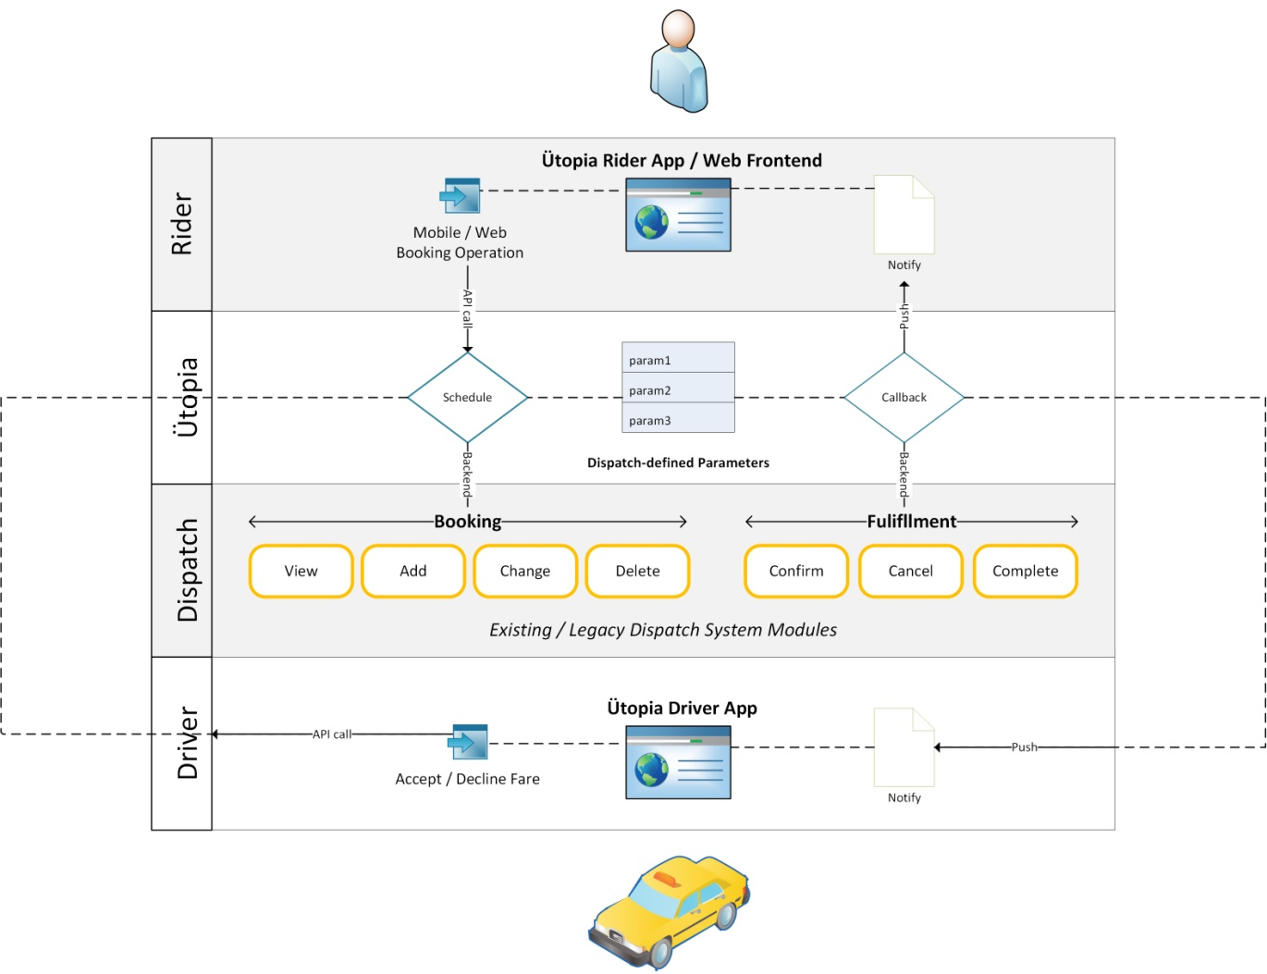
Technical Overview
Ütopia is an aggregation and federation gateway
Existing systems remain as they are
Goal is to augment existing systems, not replace

Slide 8
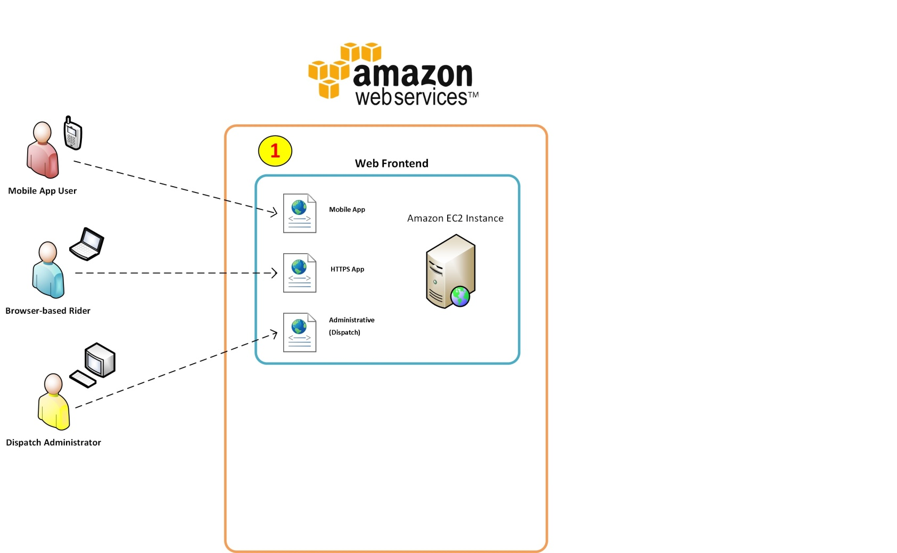
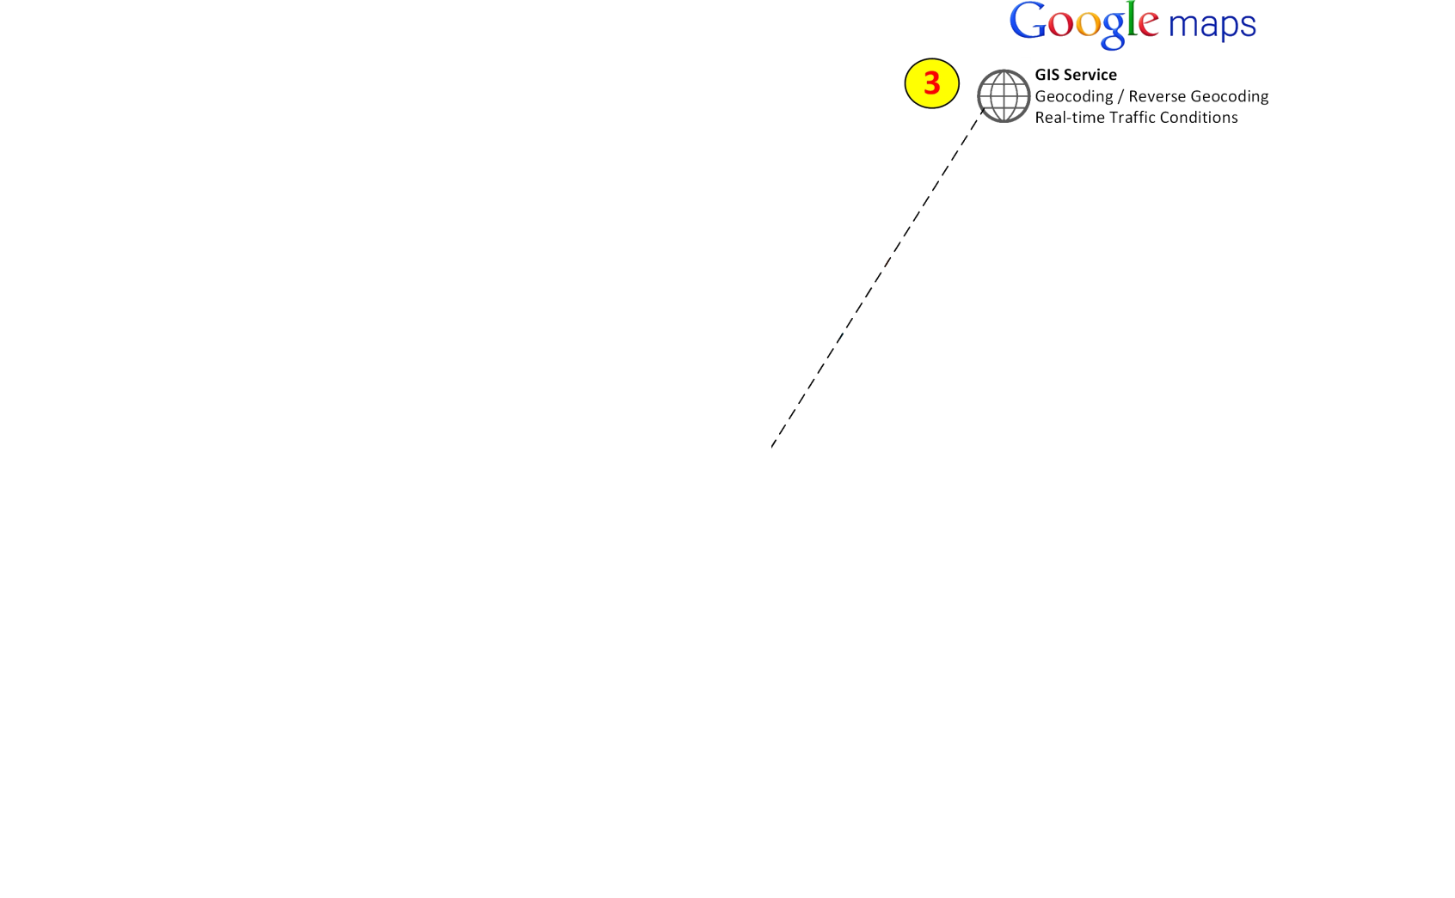
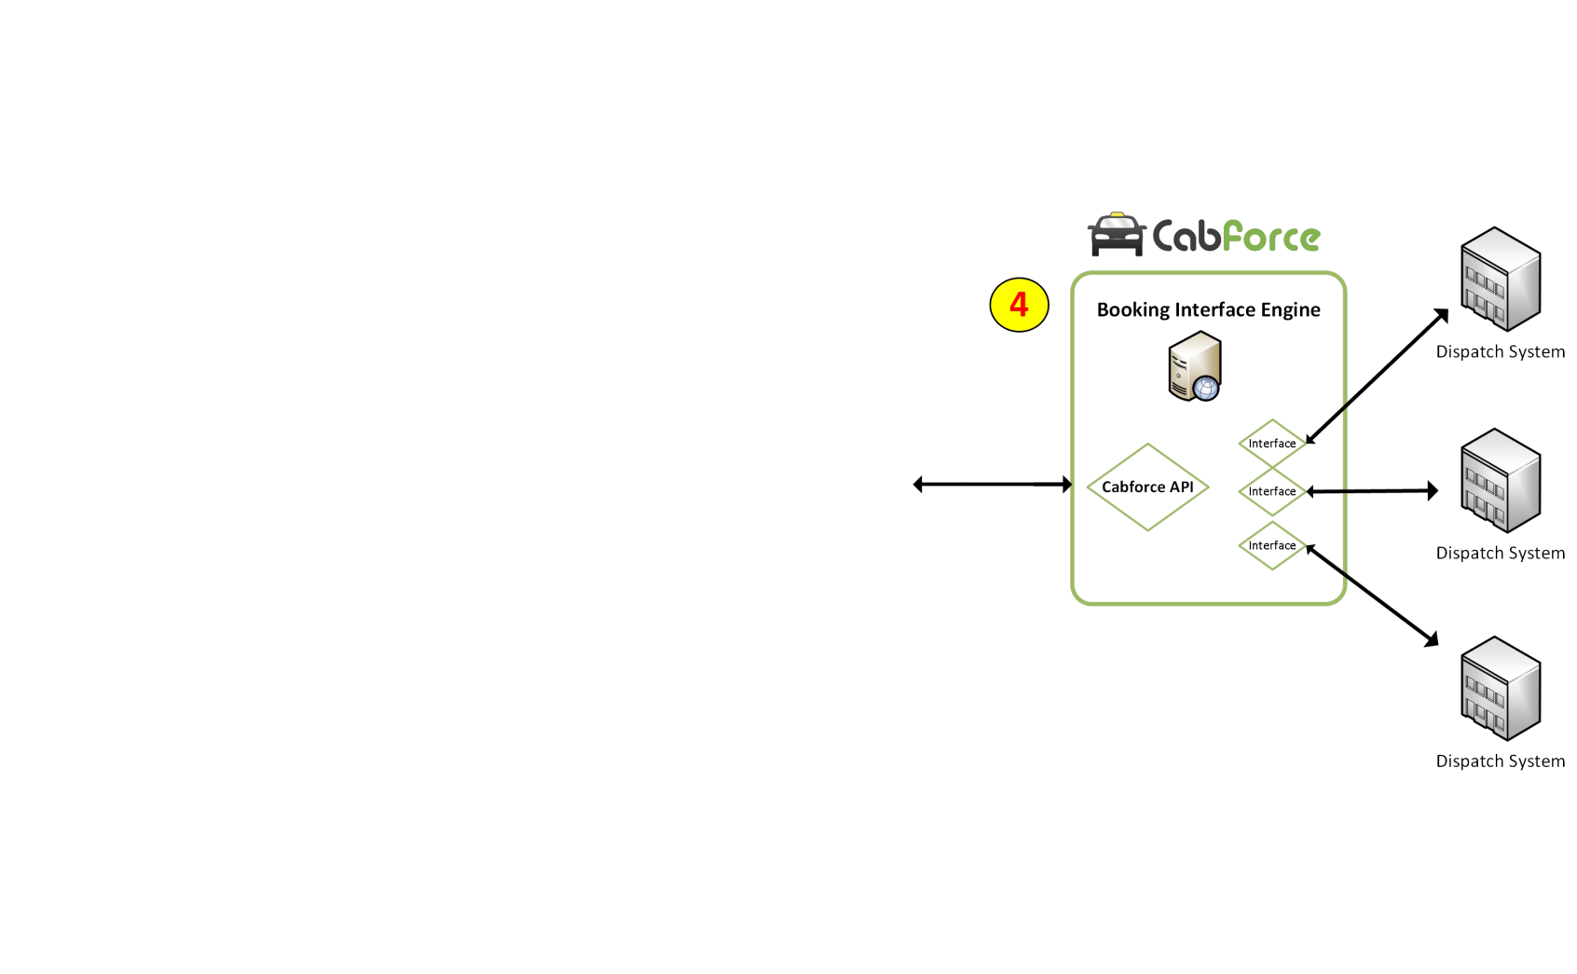
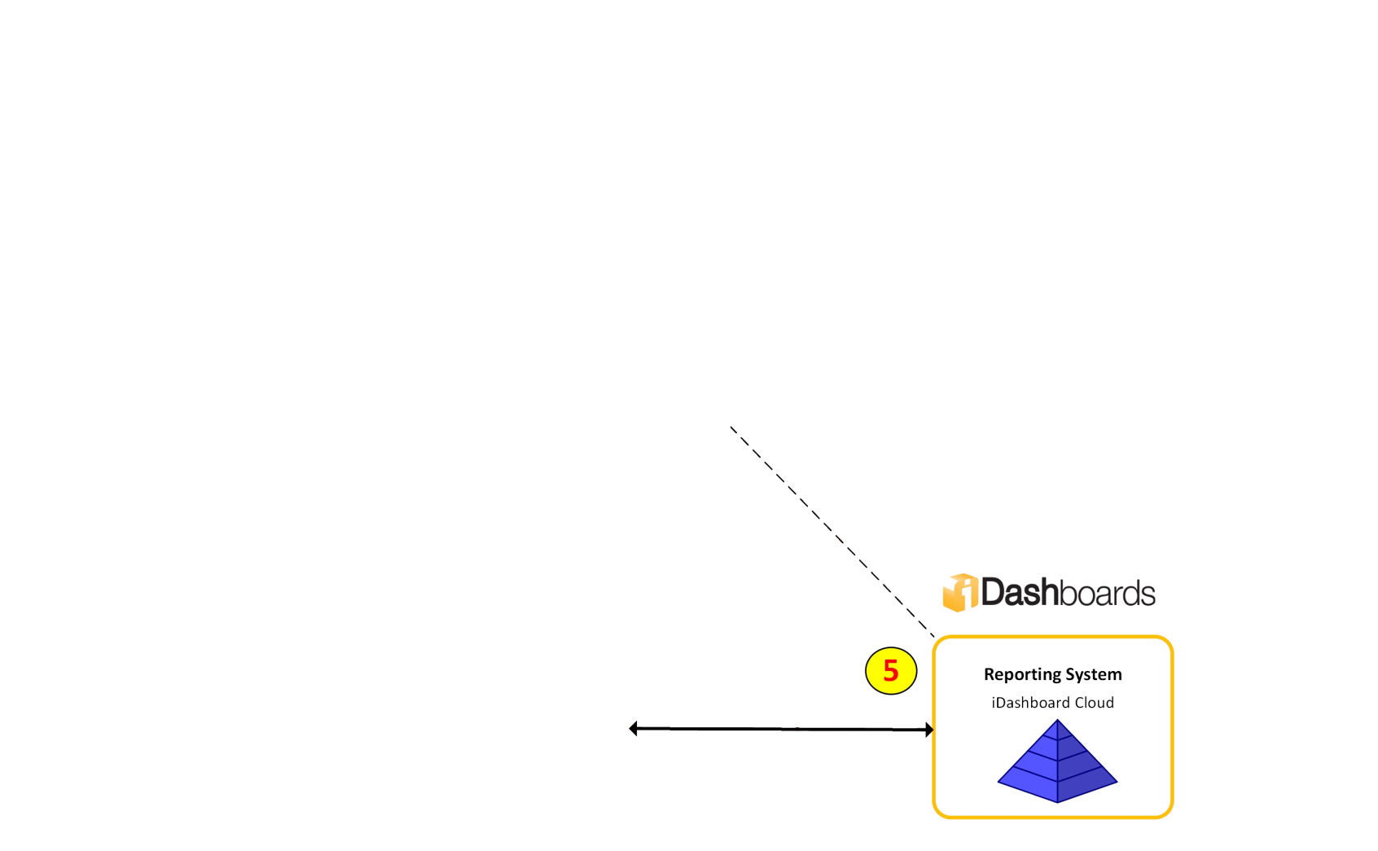
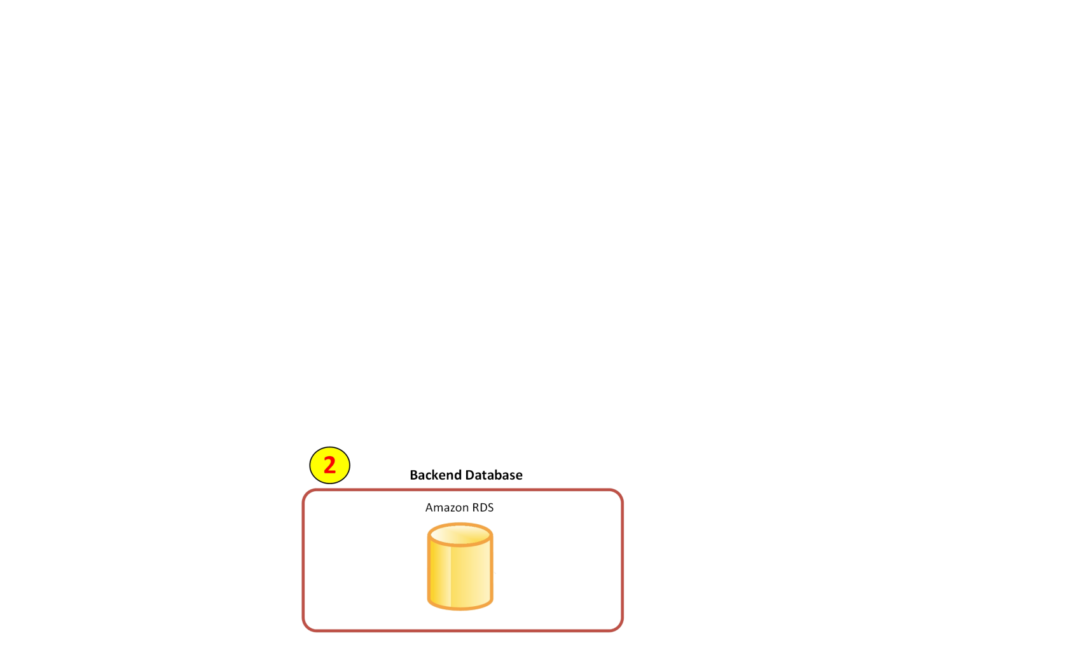
Architecture
(1) Application Frontend: Amazon EC2 Instance (CentOS 7)
(2) Backend Database: Amazon RDS (PostgreSQL)
(3) GIS Service: Google Maps API
(4) Booking Interface Engine: Cabforce API
(5) Reporting Platform: iDashboard Cloud

Slide 9
System Metrics
Metric
Value
Justification
Number of Rider Accounts
300,000
Current number of individual dispatch app users today +
15%
Number of Driver Accounts
3,000
Boston Taxi Driver Census
Number of Medallions
1,825
Fixed number
Transactional Volume (Rides/Day)
13,200
33% of total 40,000 rides, assuming 1/3 flow through
Ütopia
when it is deployed
Initial Data Volume Size (GB)
3.24GB
303,020 initial rider / driver / admin account (4KB ea.),
1,825 Medallion records (2KB ea.), approx. 80MB of
system tables and 2GB of record whitespace for trip data
Daily Data Growth Rate (MB)
206.25MB
13,200 trips at 16KB / trip
Total Storage for First 3 Years (GB)
223.79GB
3.24GB + (207.25 x 365 x 3)MB

Slide 10
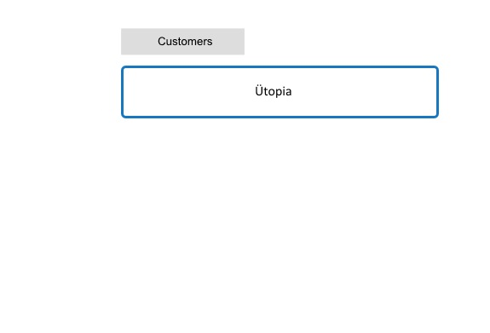
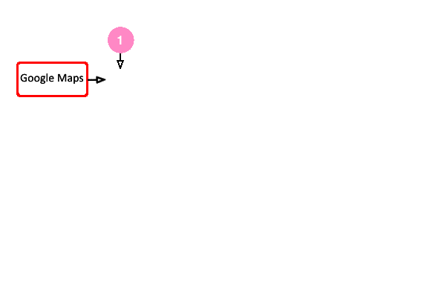
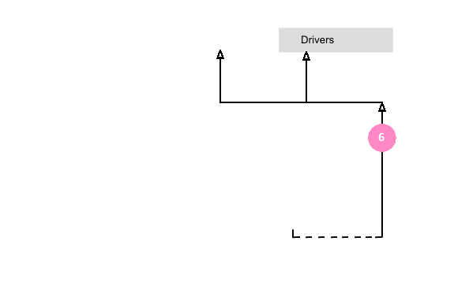
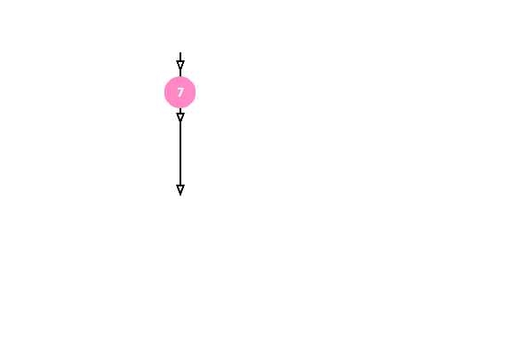
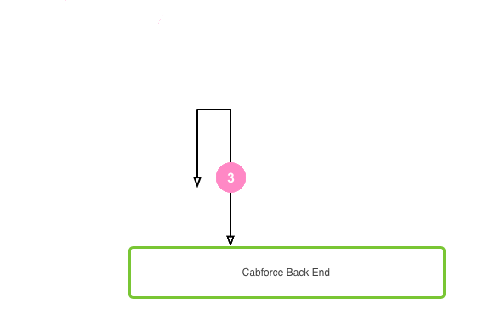
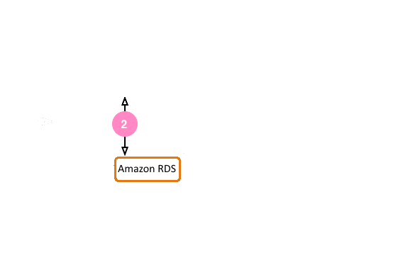

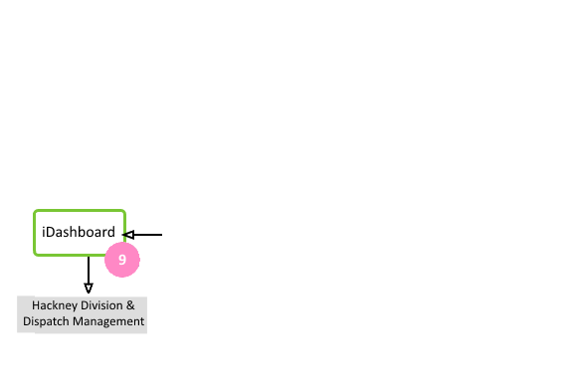
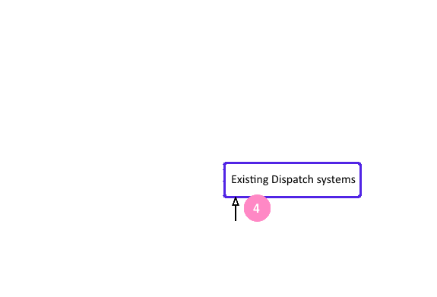

Ütopia’s integration Plan
(6) Cabforce forwards the callback to Ütopia
The rider is notified of the status of their ride
The driver is notified of a new fare via the Ütopia mobile app.
(9) The iDashboard platform interfaces with the Amazon RDS backend for report generation.
(4) The Cabforce backend forwards the booking request in a dispatch-specific format to the existing dispatch system.
(5) Booking is processed natively
A callback is sent to Cabforce with the status of the fare
(8) Ütopia sends notification dispatch system via Cabforce closes the fare.
(2) Ütopia accesses the Amazon EC2 RDS backend to retrieve Taxi information and specific user parameters.
(1)
A rider visits the Ütopia website or launches the Ütopia mobile app to request a taxi
Ütopia is linked to Google Maps to perform GIS functions and provide real-time traffic information about the proposed route.
(3)
Rider confirms their booking
Ütopia stores the information
Ütopia contacts the Cabforce backend
(7) The rider is leaves feedback
Ütopia updates the RDS fare information

Slide 11
Approach
Collaboration is key!
Iterative approach to development keeps stake holders engaged
Use of cloud based infrastructure and SaaS services enables collaboration
An internal pilot phase will be used improve the final product
Phased approach to mass deployment ensures a smooth handoff to operations
Change and Risk management is addressed and updated throughout the lifecycle of the project

Slide 12
Project Team
Role | Responsibility | Organization
Project Manager ‡ | Manages all project activities and resources for Ütopia | Ütopia
Integration Architect ‡ | Integrates existing systems and products into the Ütopia system
Ütopia Development Lead ‡ | Manages the software developers creating the Ütopia interface
UX consultant | Works with developers for Ütopia and the Testing and Usability Test coordinator to develop an easy to use interface for drivers and riders
QA Lead | Creates a test suite developed around user requirements and technical specifications. Works with the Test Coordinator, the UX consultant and the Change Management consultant to develop and implement user acceptance tests and improvement suggestions
Change management consultant | Works with Change leaders, the QA lead and the Pilot Program Coordinator to strategically prepare staff and riders about upcoming changes in processes and technologies
Training consultant | Works closely with the Pilot program coordinator to develop training programs for drivers and dispatch operators as needed
Cabforce specialist | Understands the requirements for interfacing Ütopia with cabforce
iDashboards specialist | Creates templates for dashboards and data reporting for all stakeholders
Role | Responsibility | Organization
Project Sponsor & Champion ‡ | Primary stakeholder for the Utopia project and executive sponsor | Hackney Carriage Unit
Change Leader - Top Cab, Boston Cab, I.O.T.A, City Cab, Metro Cab, Tunnel Taxi, 617Taxicab ‡ | Leads change effort in their association | Dispatch Associations
Medallion Owners Representative‡ | Acts as a liason between the Ütopia project and Medallions owners; advocates for owners needs as part of the steering committee | Medallion Owners
Usability Test coordinator | Identifies test team of drivers, collects feedback and interfaces with Utopia | Hackney Carriage Unit
Pilot Program Coordinator | Coordinates Pilot program across all dispatch associations and the Hackney Carriage Unit
Technical Consultant | Operations Director
Operations Director | Accepts handoff from Ütopia team and transitions into long term maintenance.

Slide 13
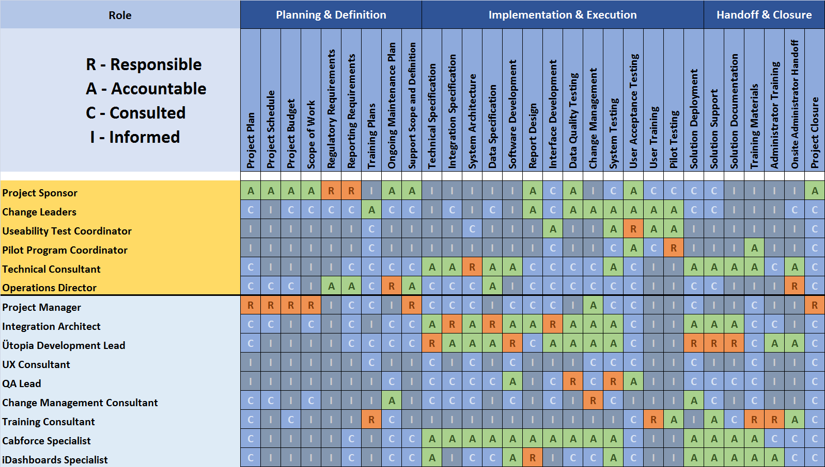
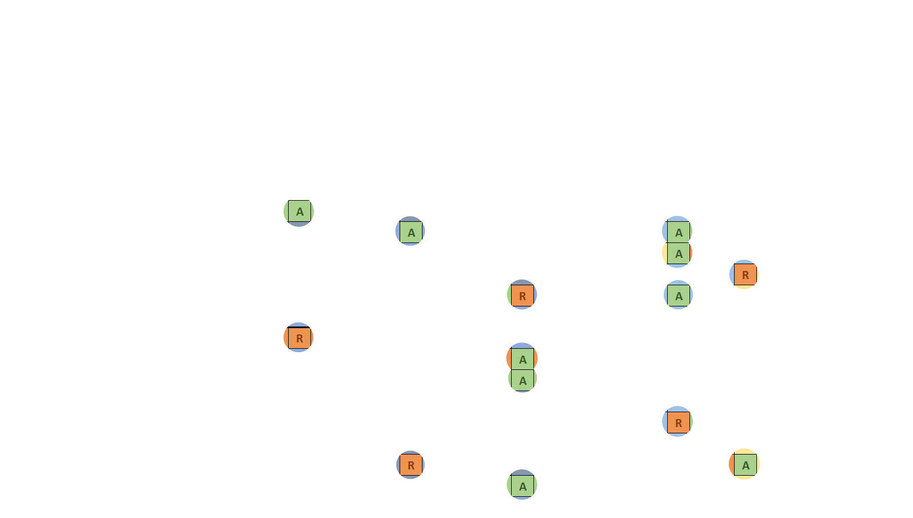
Team Responsibilities

Slide 14
Envisioning and Speculating
Phase 1
Phase 1
Ütopia Produces a scope of work document with Project Sponsor
Project charter is developed with Project Sponsor
Steering committee meets and approves the schedule
Change leaders are engaged and preliminary pilot and training plans are developed
Communication plans and styles are established for the entire team

Slide 15
Exploring and Adapting
Phase 2
Development of Web and mobile applications using iterative process
Regular involvement from stakeholders
System integration and iDashboard testing happens concurrently

Slide 16
Improving and Evolving
Phase 3
Integration tests and end to end system tests are run
Training materials are produced with Pilot program coordinator
Pilot team is recruited
Pilot program incorperates rider and driver feedback into continued development
Final changes are made to platform in preparation for ….

Slide 17
Launch and Support
Phase 4
Top Cab
Metro Cab
Boston Cab
I.O.T.A
City Cab
617 and Tunnel
Training begins with Marketing team and then drivers
Ütopia is Launched with a phased schedule based on dispatch associations
Support continues through the launch phase as Ütopia is handed off to operations

Slide 18
Operational Readiness
SLA’s will be set up with Amazon, PostreSQL, Cabforce and iDashboard
The service desk will also be part of the support for Utopia
Change control processes will be integrated with the DE group
Ownership lies with the internal IT Desktop Engineering group within the City of Boston

Slide 19
Change Management
Security Patch
Status
Change Activity
Test
Security vulnerability
CentOS service pack
Development environment
Monthly change control
Emergency change control
Out of band
Backout plan

Slide 20
Tiers of Support
Tier 4
Tier 1
Tier 3
Tier 2
Service Desk
Escalations
Field Support
Systems Engineering

Slide 21
User Enablement
Processes
Documentation
Training Videos
Knowledge Management
Mobile application
iDashboard reports
User Administration page
3 Customer Facing Applications

Slide 22
Demo

Slide 23
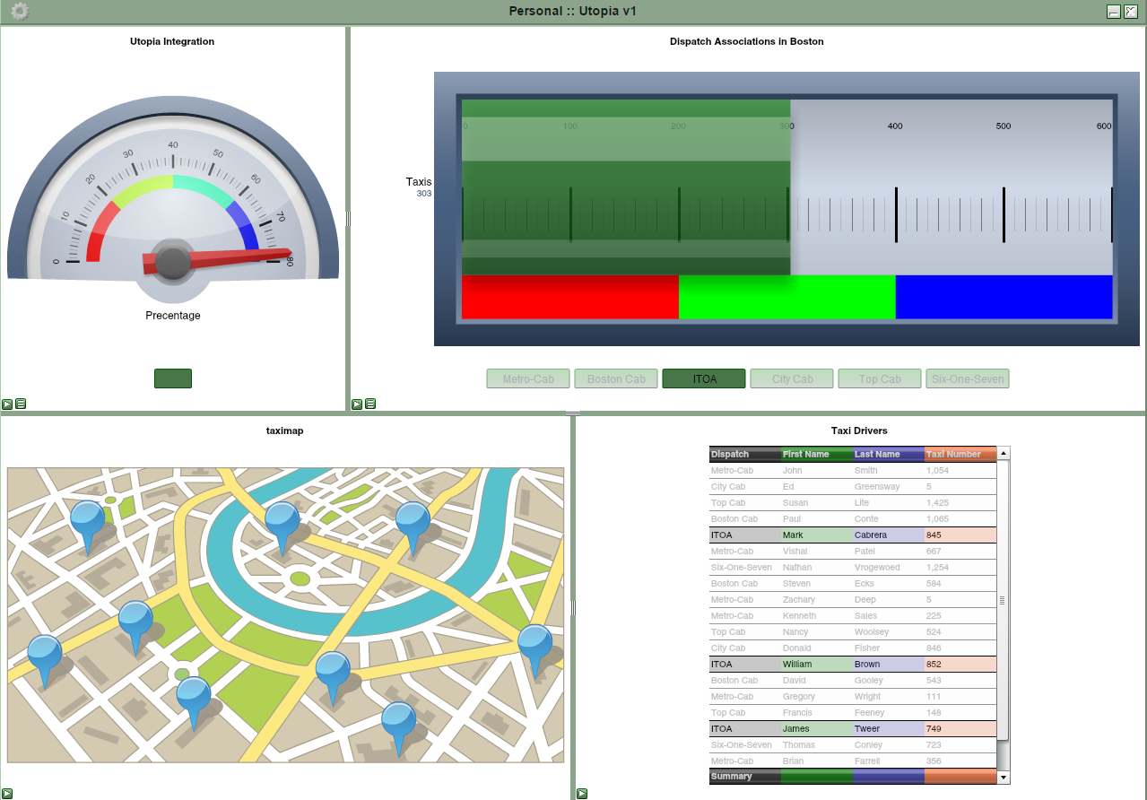
Demo

Slide 24
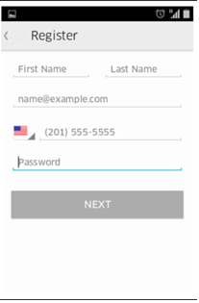
Demo

Slide 25
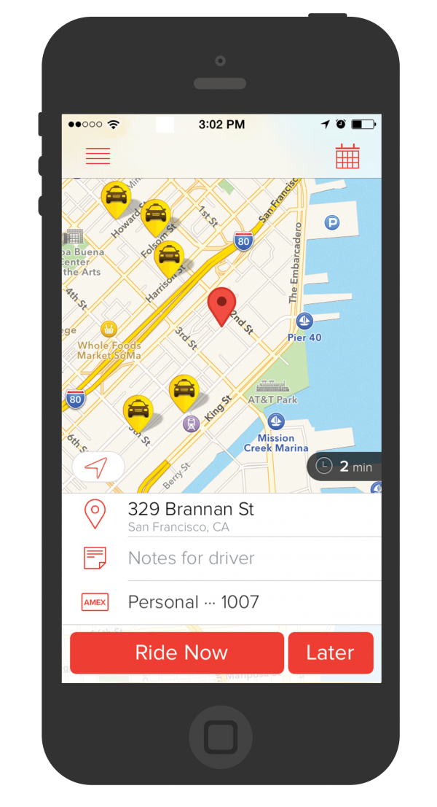
Demo

Slide 26
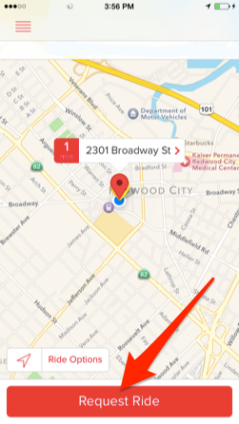
Demo

Slide 27
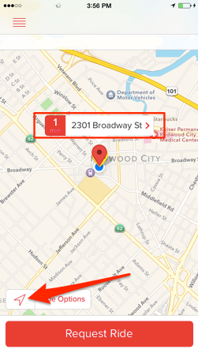
Demo

Slide 28
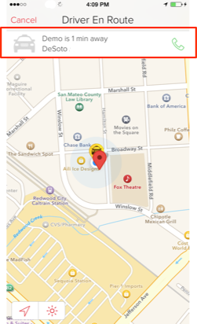
Demo

Slide 29
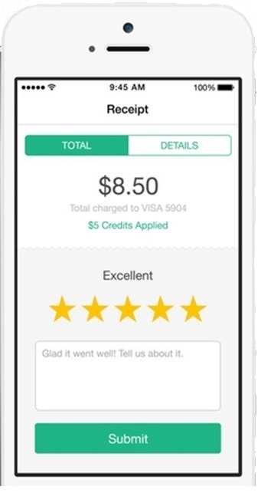
Demo

Slide 30




SUCCESS METRICS
Average Passenger Wait time using Utopia to be less than 5 minutes
Percentage of Dispatch Requests served above 95%
Taxi Utilization above 40%
Average total ridership to increase 5% per year for the next 5 years

Slide 31

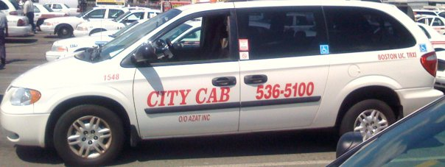


KEY PERFORMACE INDICATORS (KPI)
Individual medallion owner adoption
Individual driver adoption and usage
Overall Dispatch Association adoption

Slide 32
TAXI ADVISORY COMMITTEE (TAC)
Large medallion owners
Small medallion owners
Shift drivers
3 Radio associations
City of Boston Transportation Department
City of Boston Office of Neighborhood Services
City of Boston Commission for Elder Affairs
Boston College Student President
Boston University Student President
Northeastern University Student President
Harvard University Student President
Massport
MBTA Accessibility Office
Massachusetts Convention Center Authority

Slide 33


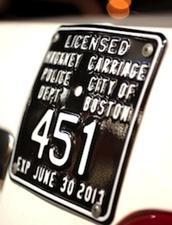
https://www.pinterest.com/pin/67554063132506162/
https://www.bostonglobe.com/2013/03/13/hackney/6BryhorQKXYPXm5mznO6iM/story.html
http://www.glgcars.com/qa/

